Slide 1

Federal Traveler/ Arranger Advanced
United States Coast Guard

Slide 2
Agenda
1
Training Objectives
2
Amending Authorizations
3
Open Authorizations
4
5 minute Break
5
Group Authorizations
6
Supplemental Vouchers

Slide 3
Objectives
Amendments
Open and Group Authorizations
Creating
Supplemental Vouchers
Understanding when an authorization needs to be amended and amending authorizations, to include changing reservations.
Creating open and group authorizations, creating trips, and other actions available for open and group authorizations.
Creating a supplemental voucher for expenses not claimed on the final voucher.

Slide 4
Icons are used in this presentation to help identify the type of information being delivered.
They are found in the upper left corner of applicable slides.
New information
Scenarios
Information recap
Knowledge reviews

Slide 5
Arranging
Travel for Others
Notes:
Travel For Others in ETS is similar to Proxy in TPAX.

Slide 6
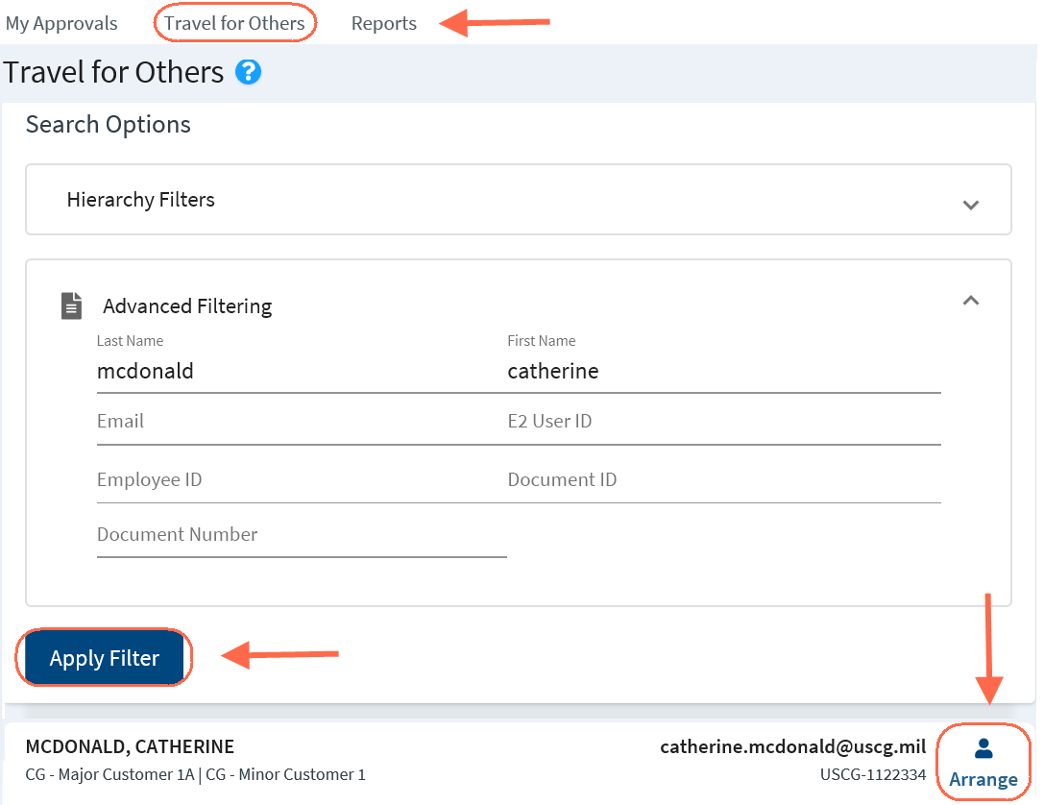
Travel for Others
Creating Travel Documents for Another Traveler
Notes:
Travelers can create, modify, cancel, delete, and print travel documents for their own travel.
Arrangers can also perform these actions for travelers who have given them permission to arrange their travel or by permissions granted by USCG.
Any user, regardless of user type or role, can be designated as a travel arranger.
On the My E2 taskbar, click Travel for Others.
Enter your search criteria to search for a specific user.
Click Apply Filter.
Click Arrange next to the traveler’s name to view or create their trips.

Slide 7
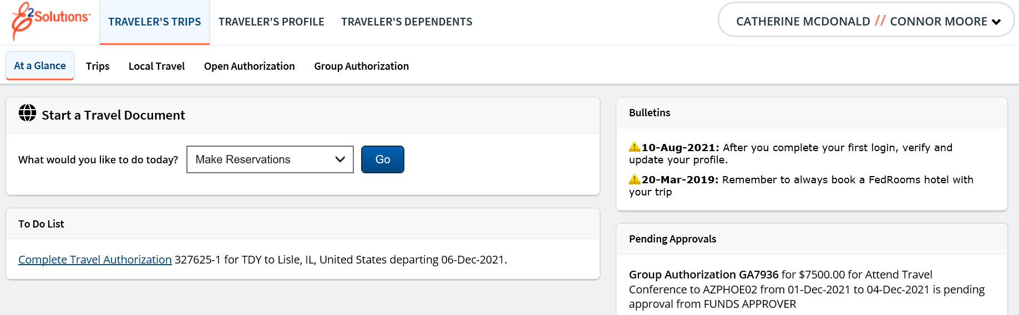
Travel for Others
Creating Travel Documents for Another Traveler
Notes:
The name of the user you are arranging for displays next to your name in the upper right corner.
As an Arranger, you have access to the traveler’s trips and profile.
To exit the Arranger session, click the User Options Menu and select Stop arranging for, and you will be returned to the Travel for Others page.

Slide 8
Amending Authorizations

Slide 9
Amending Authorizations
Once a trip is approved, an amendment needs to be created if the travel dates or location changes, or if additional funding needs to be added to the trip.
Most changes to an approved authorization requires approval.
If you make limited changes to the authorization such as returning a day early, the amended authorization will be automatically approved.
Notes:
When you create an amendment, the following actions occur:
Authorizations
The original authorization goes to Amended status.
The newly created authorization goes to New Authorization status if no reservations exist or Reservations Booked status if reservations exist.
The amendment number is appended to the trip ID.
Amendments are sequentially numbered. The first amendment appends “-1” to the trip ID; the second amendment appends “-2” and so forth.
If you have an “in progress” voucher (in Open or Revised status) at the time you amend an authorization, the amendment process deletes that voucher. After the authorization amendment reaches final approval and you create a new voucher for the trip, you can select to Use Only Approved Amendment Expenses or Use Only Pre Amendment Voucher Expenses.

Slide 10
Scenario 1
Amending an Approved Authorization:
The traveler’s upcoming trip from Washington, DC to Minneapolis, MN and Jacksonville, FL has been approved but the return date needs to be changed to return one day earlier. Since the traveler booked their reservations in E2 initially, and the ticket has not yet been issued, the traveler will be able to change the reservation while amending the authorization.
Reservations
Change the return flight from Jacksonville, FL (JAX) to Washington, DC (IAD), and the hotel to return one day earlier than planned.
Site Details
Update the returning date.
Expenses
Lodging and M&IE will adjust automatically for new dates. Other expenses can be modified, added or deleted if needed.
Remarks
Add a remark to indicate why you are amending the trip.
* Instructor may adjust travel sites as needed

Slide 11
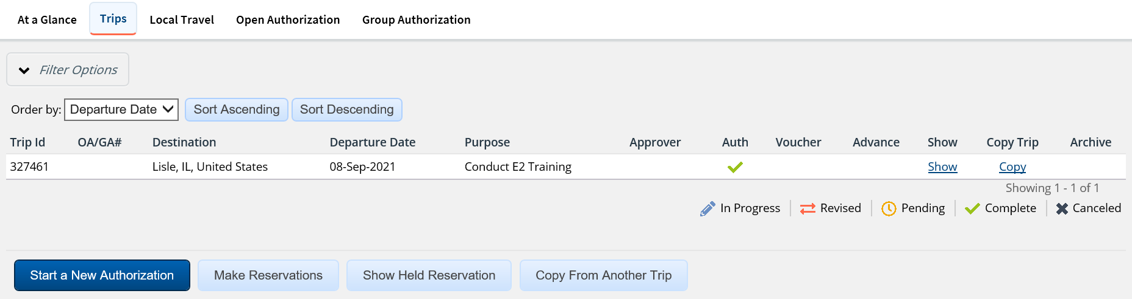
Amending an Authorization
Selecting the Authorization to Amend
Notes:
From the Trips tab, click Show to access a trip. If the trip is approved, the trip dashboard is automatically displayed. If clicking Show takes you into the document, click the Trip Dashboard tab in the upper left corner of the document.

Slide 12
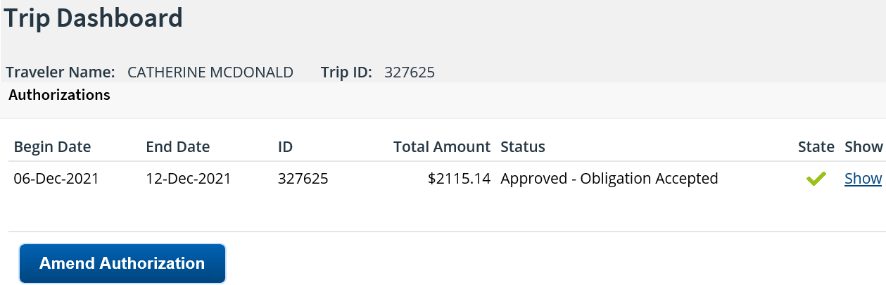
Amending an Authorization
Trip Dashboard
Notes:
To make changes to an approved authorization, click Amend Authorization.

Slide 13
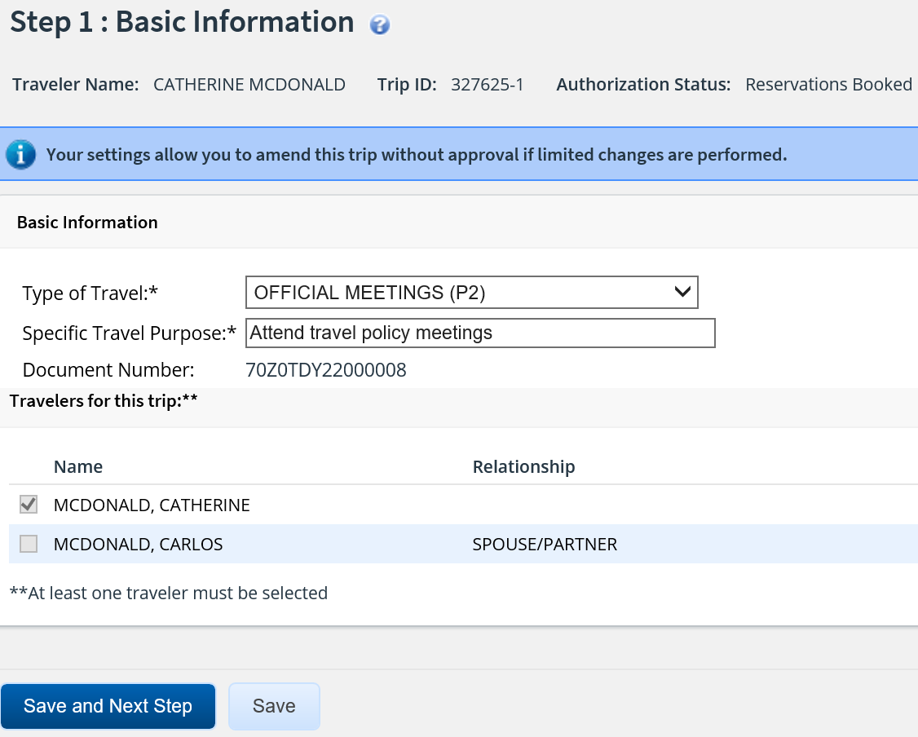
Amending an Authorization
Step 1: Basic Information
Notes:
Once you click Amend Authorization, the Basic Information page for that authorization appears. You can modify the following:
Type of Travel
Specific Travel Purpose

Slide 14
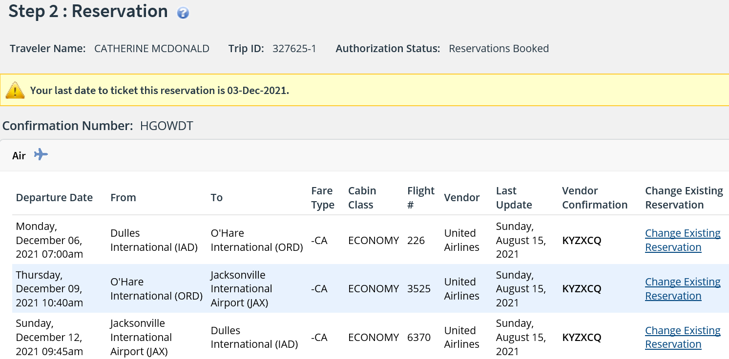
Amending an Authorization
Step 2: Reservation
Notes:
As part of the amendment process, you may need to retrieve, change, add, or delete travel reservations.
You can make changes to your reservation online if the reservations were made using the E2 online booking tool and the reservations have not been ticketed.
Use Change Reservations to access the online booking tool and make changes.
If the Change Reservation link is not available, contact the TMC to change your reservation.

Slide 15
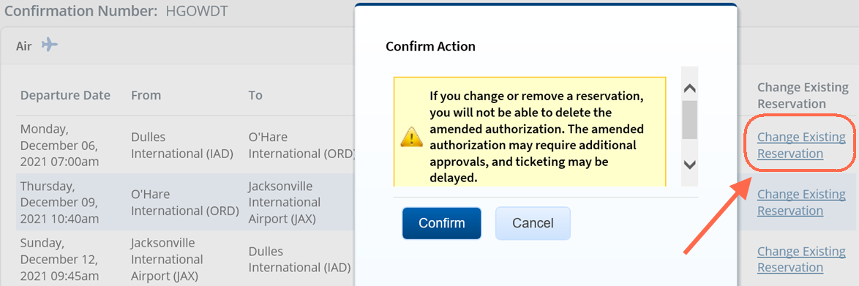
Amending an Authorization
Changing Existing Reservation
Notes:
A message advising if you change or remove a reservation, you will not be able to delete the amended authorization.
Click Confirm to continue to the online booking tool or Cancel to return to the Reservation step.

Slide 16
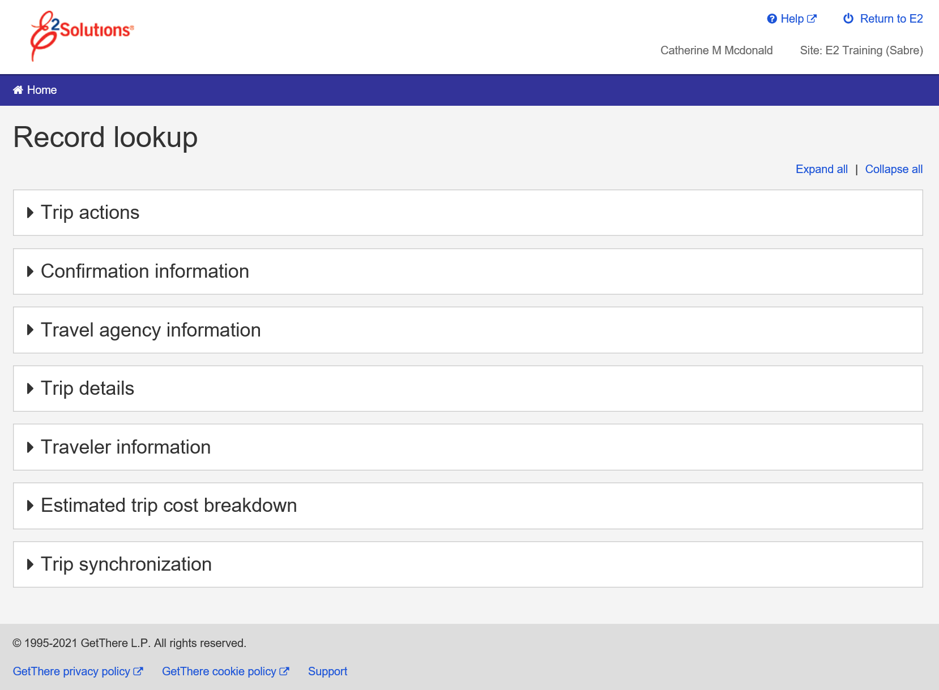
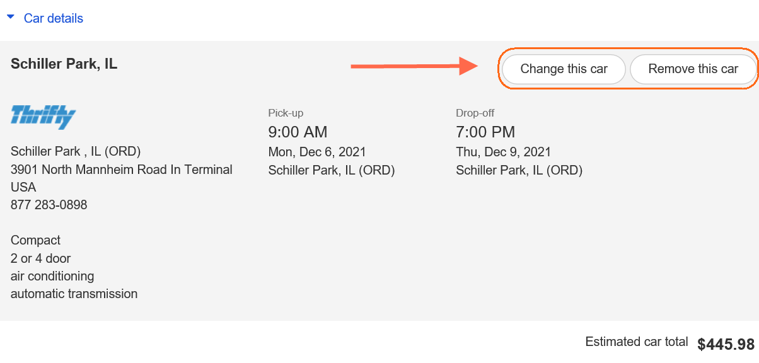
Amending an Authorization
Changing Existing Reservation
Notes:
The confirmation for the existing reservation is displayed. All sections can be expanded to review the details.
For those sections that allow change, click the appropriate button to either change or remove.

Slide 17
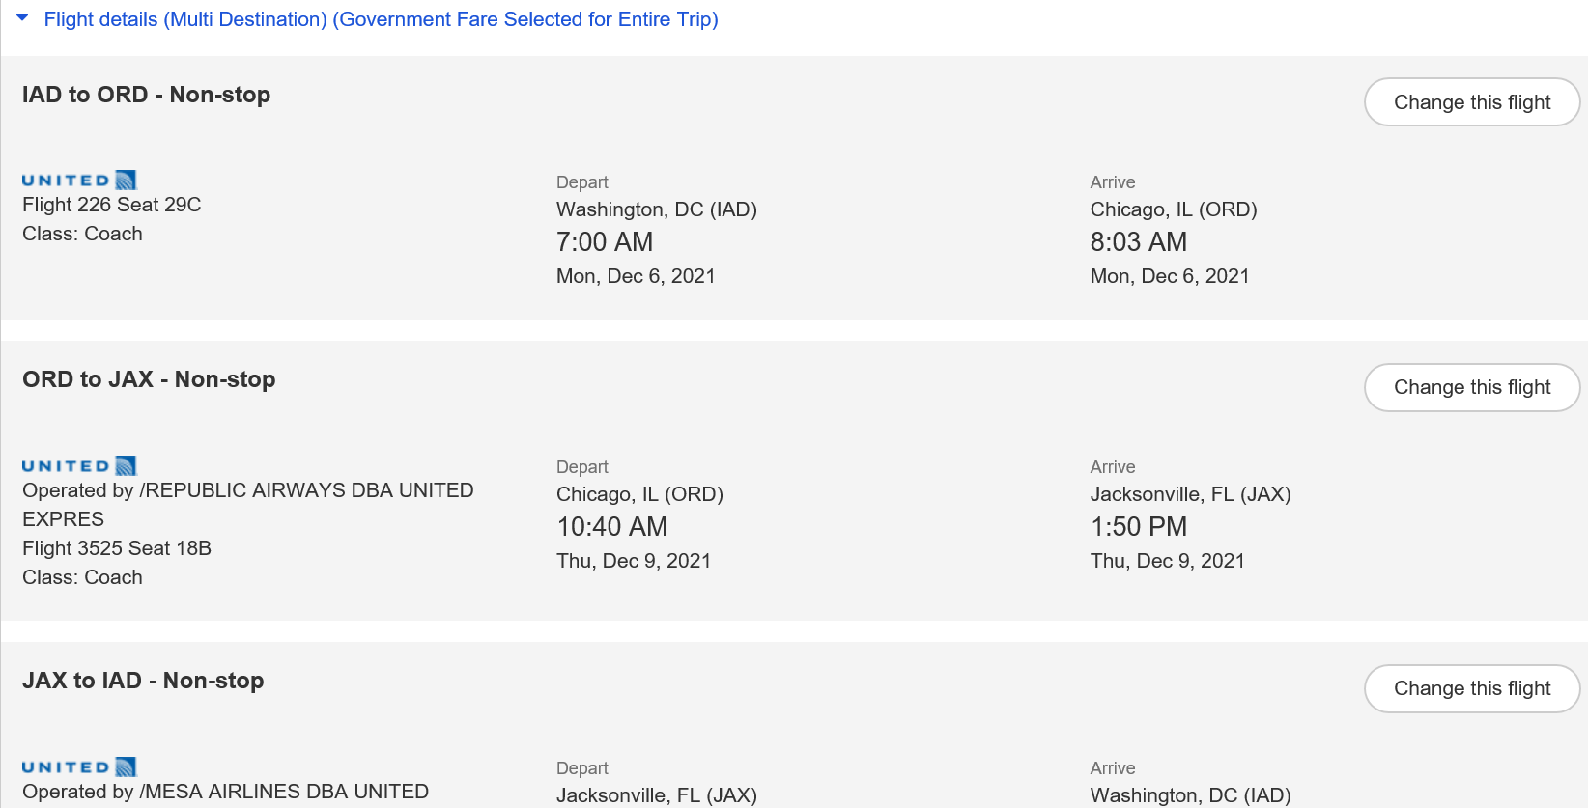
Amending an Authorization
Changing Flights
Notes:
To change your flight, click Change this flight.
You will be prompted to select a new date and book flights using the same process used on the initial booking.

Slide 18
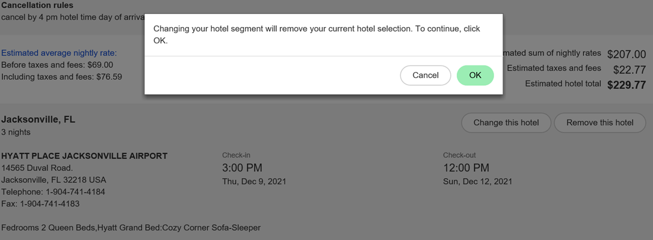
Amending an Authorization
Changing Hotel Reservation
Notes:
To change hotel details, click Change this hotel. A message displays advising this will remove your current hotel selection.
Click OK.
You will be prompted to select a new hotel following the same process used during the initial booking.

Slide 19
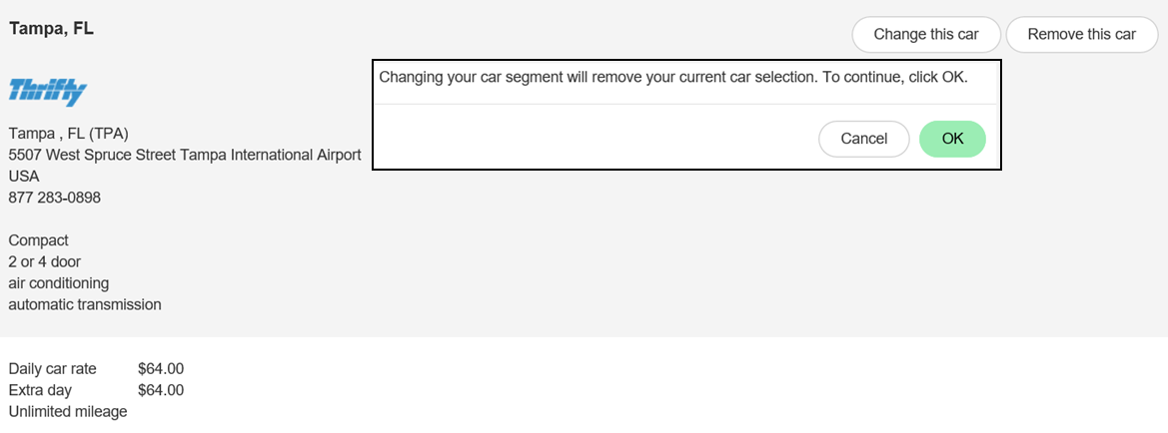
Amending an Authorization
Changing Car Rental Reservation
Notes:
To change rental car details, click Change this car. A message displays advising this will remove your current car selection.
Click OK.
You will be prompted to select a car using the same process used on the initial booking.

Slide 20
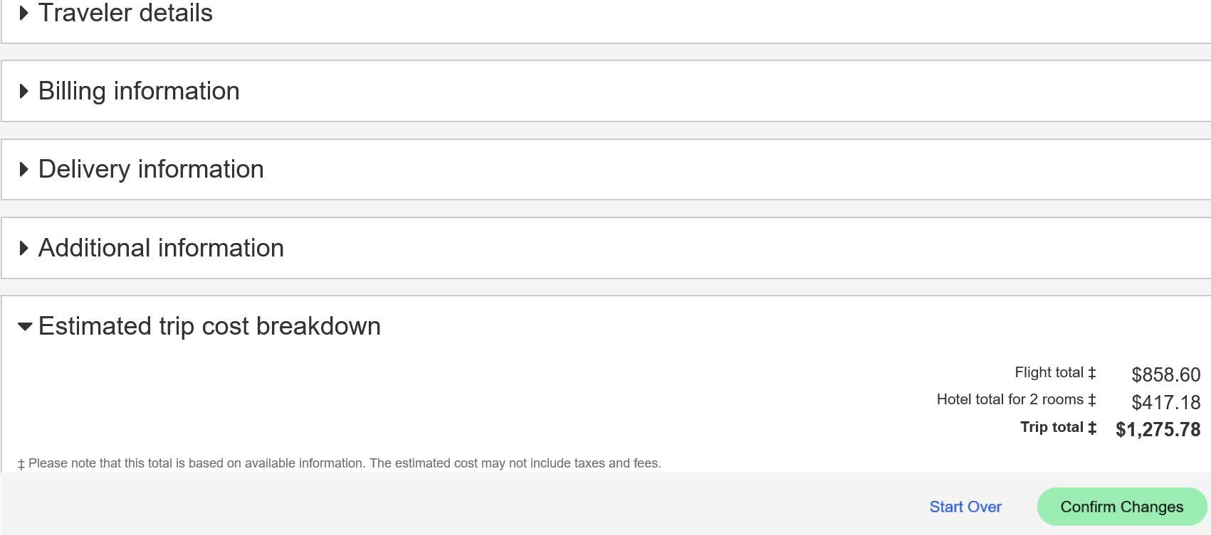
Amending an Authorization
Confirming Reservation Changes
Notes:
Once all trip components have been changed, scroll to the bottom of the Trip Review and Summary page and click Confirm Changes.

Slide 21
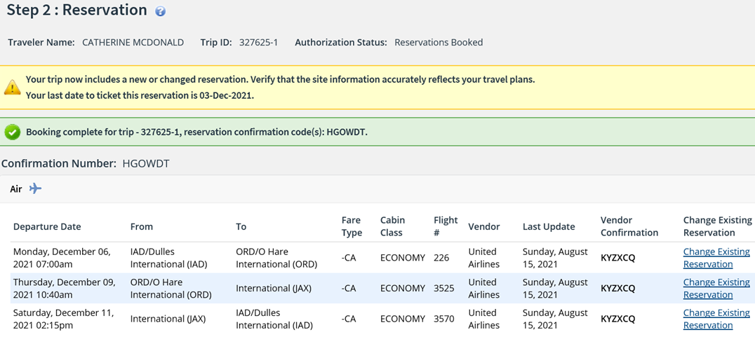
Amending an Authorization
Step 2: Reservation
Notes:
After confirming changes you are returned to the Reservation Step.

Slide 22
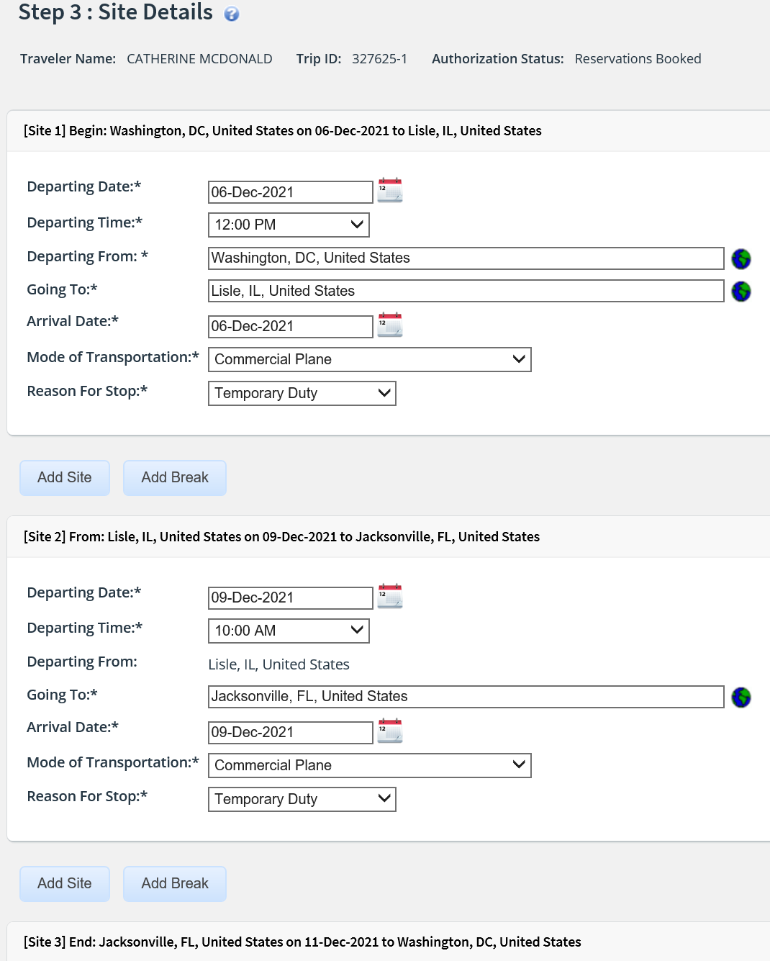
Amending an Authorization
Step 3: Site Details
Notes:
Use the Site Details page to make changes to your trip per diem locations or travel detail information, including travel dates.
If the original authorization had associated reservations, the information on this page comes from those reservation details. If, however, you change the reservations during the amendment process, the Site Details page does not reflect that changed information. You will be alerted of this situation by a warning message.
You should always review the Site Details page to verify that it reflects your current travel plans, and that the dates and per diem location information is accurate.
You cannot make changes for any dates for which you have been paid lodging, or meals and incidental expenses (M&IE), on a voucher.

Slide 23
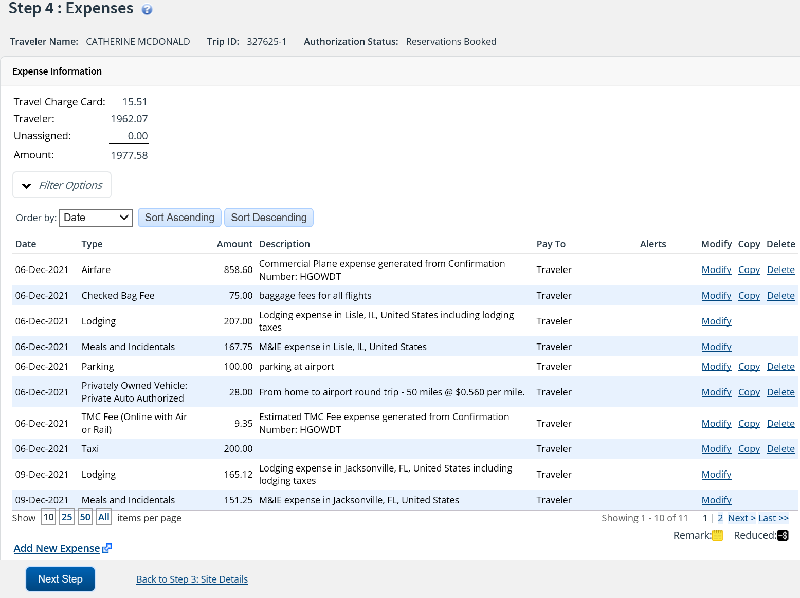
Amending an Authorization
Step 4: Expenses
Notes:
If you make changes to your travel itinerary or your reservations, you should always review your new estimated expenses and the selected reimbursement types associated to your Lodging and Meals & Incidentals.
Transportation and other expenses can be added, changed, or deleted.
Lodging and Meal & Incidentals expenses can be changed for dates for which expenses have not been paid on a previously submitted voucher.
[JTR] When the Reimbursement Type field for at least one day in the Meals and Incidentals expense window is set to EUM or GMR/PMR, the incidental amount allowed for the corresponding day may be modified (i.e., reduced, or returned to the original incidental per diem rate for the trip site), provided the authorization does not have one closed voucher. If a closed voucher exists, the Reduced Incidental Amount value from the original authorization will be carried forward to the amendment and any future vouchers, and the Reduced Incidental Amount Modify link will not display in the amended authorization’s Meals and Incidental Expenses window.

Slide 24
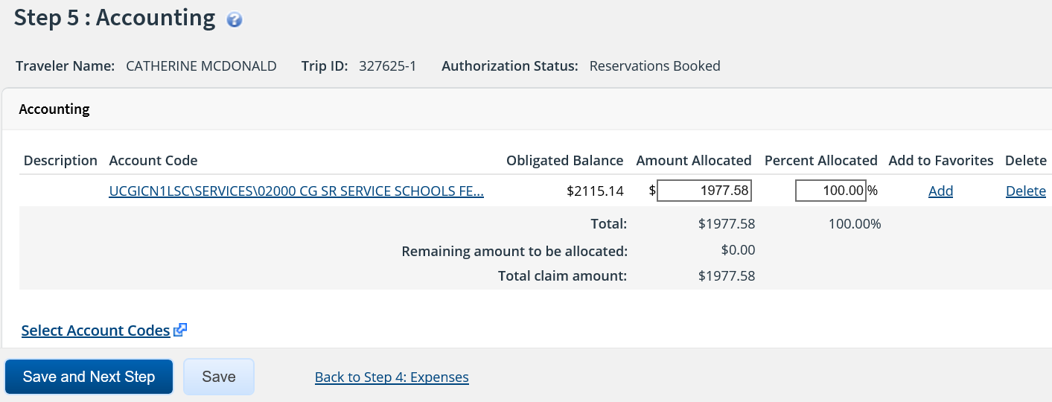
Amending an Authorization
Step 5: Accounting
Notes:
The POET line or lines used on the original authorization carry over to the amended authorization.
Your Funds Manager approver will adjust the account codes, if necessary.
Click Save and Next Step.

Slide 25
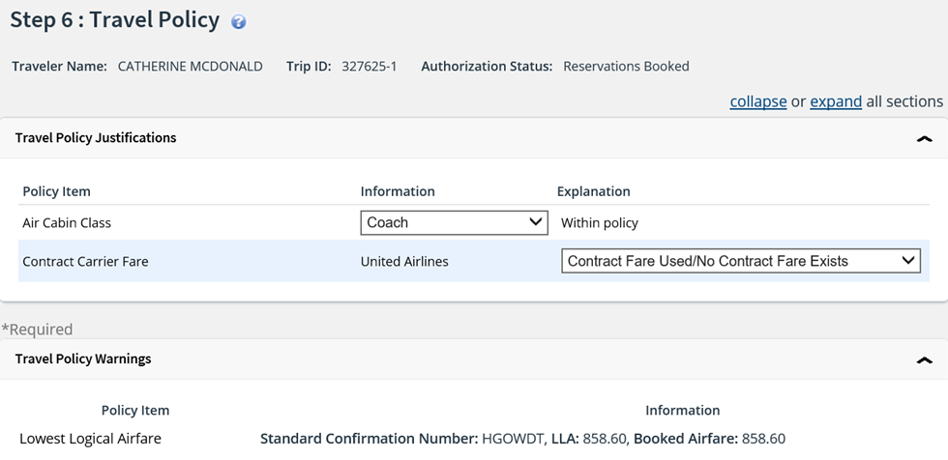
Amending an Authorization
Step 6: Travel Policy
Notes:
The Travel Policy page displays information about your trip that may be outside of your agency travel policy.
If any of your travel selections are considered out of policy, you must select explanations for the items.
The Travel Policy page also displays contracted fare information for any city pairs that exist for your trip. (All listed fares are one-way fares.)

Slide 26
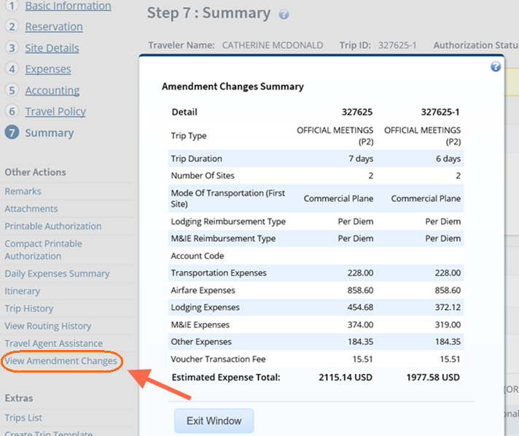
Amending an Authorization
View Amendment Changes
Notes:
To view a comparison of the original authorization and the amendment, click View Amendment Changes under Other Actions.

Slide 27
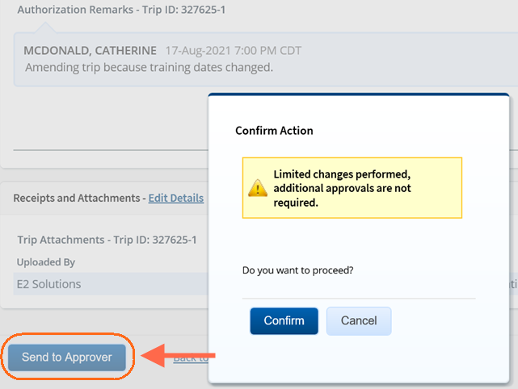
Amending an Authorization
Send to Approver
Notes:
When you have finished making your changes, the amended authorization must be submitted for approval.
Click Send to Approver to submit the amended authorization.
Validation checks are performed and any exceptions will be listed in the Confirm Action modal.
If the document is routed for approval, you will receive email notification as your amended authorization moves through the approval process.

Slide 28
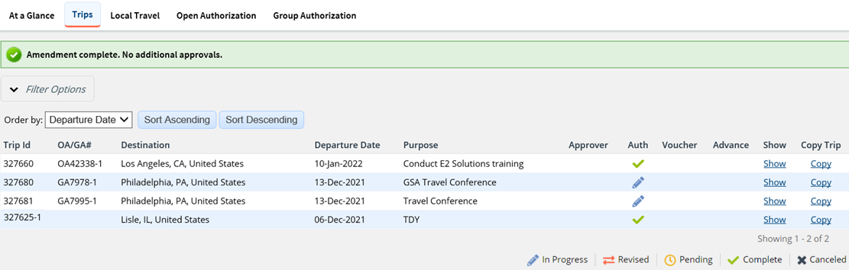
Amending an Authorization
Amendment Complete
Notes:
If your amended authorization has limited changes and does not need additional approval, it will automatically moved to an approved state.

Slide 29
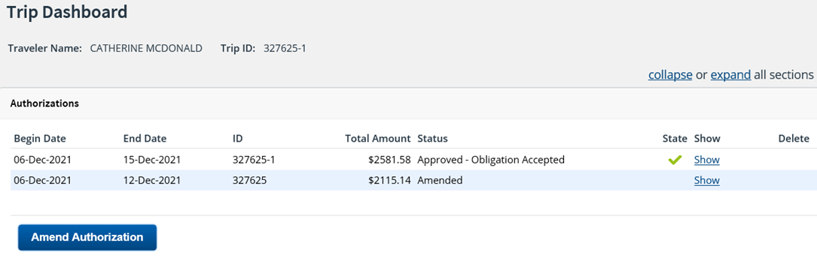
Amending an Authorization
Trip Dashboard
Notes:
When you view the Trip Dashboard of the recently amended authorization, you will notice both the original version of the trip and the new version are displayed.
The original version of the trip now has the status of Amended and the new version has a status of Approved – Obligation Accepted. The trip ID also displays a ‘-’ and the amendment version for this authorization. A trip can be amended as many times as necessary.

Slide 30
Review
Amending Authorizations
If the authorization is still pending approval and the dates of travel have changed, what can a traveler or arranger do to make the changes?
The traveler can recall the authorization,
make changes and resubmit to the approver.
A ‘-1’, ‘-2’, etc. is added to the Trip ID to indicate the trip has been amended.
When viewing a Trip ID, how can you tell if the authorization has been amended?
When amending a trip, the site details need to be updated to reflect changes to dates and locations. True or False?
True. The dates and/or location changes need to be updated on the site details step.
Once an authorization has been amended, what will the status of the original authorization be?
The status will be Amended. The amendment can always be viewed from the trip dashboard.

Slide 31
Creating Open Authorizations

Slide 32
Open Authorization
Open authorizations (often known as "blanket authorization" or OA) are pre-approved requests to travel during a specified time period. They may be limited to specific time periods, locations, or maximum costs. An open authorization can cover multiple trips for up to one fiscal year.
Open authorizations can be created manually in E2 by a traveler or an arranger.
USCG will also have an automated process where some OA’s will be created automatically by USCG systems, and populate into E2 as an approved OA.
Travelers or arrangers can create trips under an approved authorization, whether it was created manually or under the automated process.
If travel requests conform to all of the properties and limitations of the approved open authorization, it automatically inherits the approval status of the open authorization and does not require additional approval steps.
Notes:
Automated OAs that will be populated from Direct Access will typically be those for Schools, Reservist or PCS (more details will be provided on this once processes have been finalized).

Slide 33
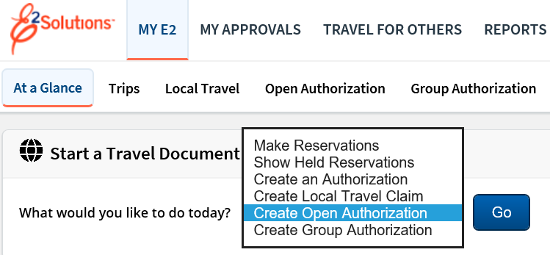
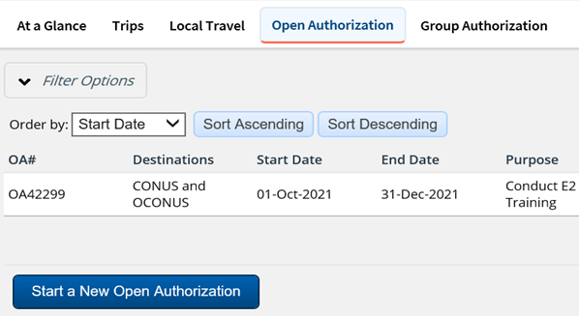
Creating Open Authorizations
Notes:
Open Authorizations can be created from Start a Travel Document list on the My E2 At a Glance page or from the Open Authorization tab by clicking Start a New Open Authorization.

Slide 34
Scenario 2
Create Open Authorization
The traveler will be taking several trips to conduct site inspections at various locations during the next several months. Create an open authorization to use for these trips and submit it for approval.
Basic Information:
Purpose of Travel: Site Inspections at various locations
Allowable Types of Travel: Site Visit
Travel Dates: Travel period covering 3 months
Travel Details:
Allowed Destinations: Inside the continental U.S. (CONUS)
Allowed Transportation: Select Commercial Plane, and any others
Expense Details:
Per Trip Expense: Not Required
Total OA Expenses: $20,000
Advances: Allowed after authorization approval
Reimbursement Types: Do not allow Actual Lodging or M&IE
* Instructor may adjust travel sites as needed

Slide 35
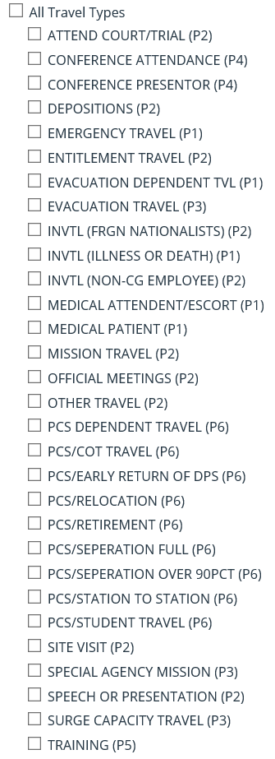
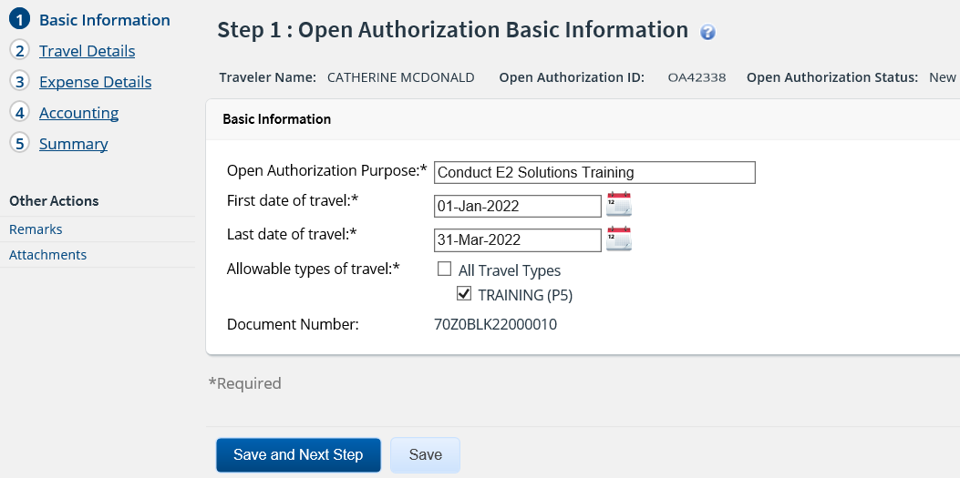
Creating an Open Authorization
Step 1: Basic Information
Notes:
The Basic Information page allows you to select the settings that will apply to all trips created under the OA, including:
Type and purpose of all travel under the OA
First and last days of travel allowed (maximum 1 year)
When you complete and save the Basic Information page, E2 creates the OA document and assigns it a document number.
This is the first step in the open authorization workflow. No other steps are enabled at this time. You must complete this step in the process before you can proceed.

Slide 36
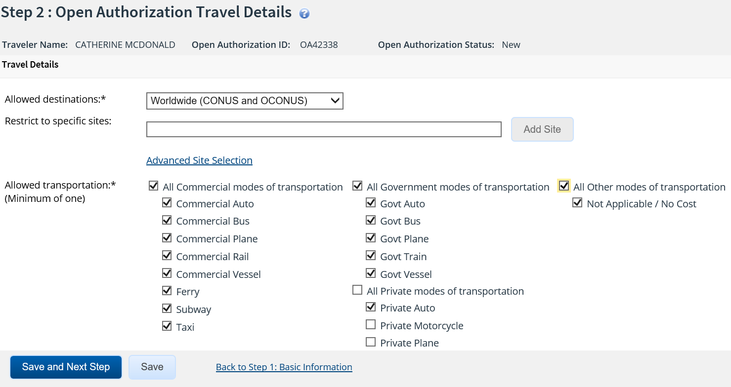
Creating an Open Authorization
Step 2: Travel Details
Notes:
Use the Travel Details page to select your allowed destinations, sites, and transportation modes.
When selecting Allowed destinations:
CONUS – Continental U.S. (48 contiguous states)
OCONUS – Outside Continental U.S.
Worldwide – any destination
If the traveler will be restricted to specific sites, enter the location, and click Add Site.
Use the Advanced Site Selection to limit the user to all sites within a country, or within a state if U.S. is selected.

Slide 37
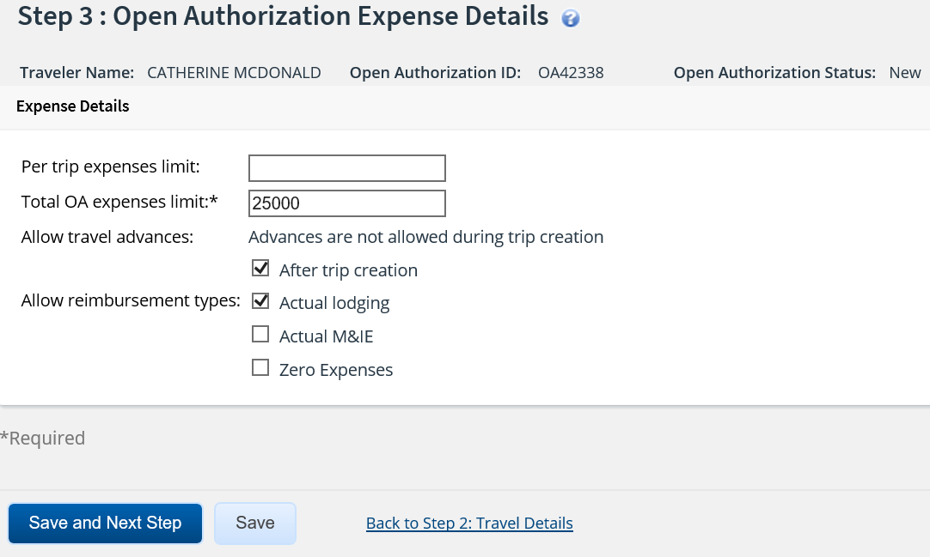
Creating an Open Authorization
Step 3: Expense Details
Notes:
The Expense Details step allows you to limit expenses on trips created from an OA.
Trips created under the OA that exceed the limitations will route for approval.
The Per Trip Expense Limit is not a required field for USCG and can be left blank.
Enter an amount for the Total OA expenses that will cover all trips created under this OA.
Click the checkbox to indicate if travel advances can be requested on trips created under this OA.
Click the checkboxes to indicate other reimbursement types that will be permitted.

Slide 38
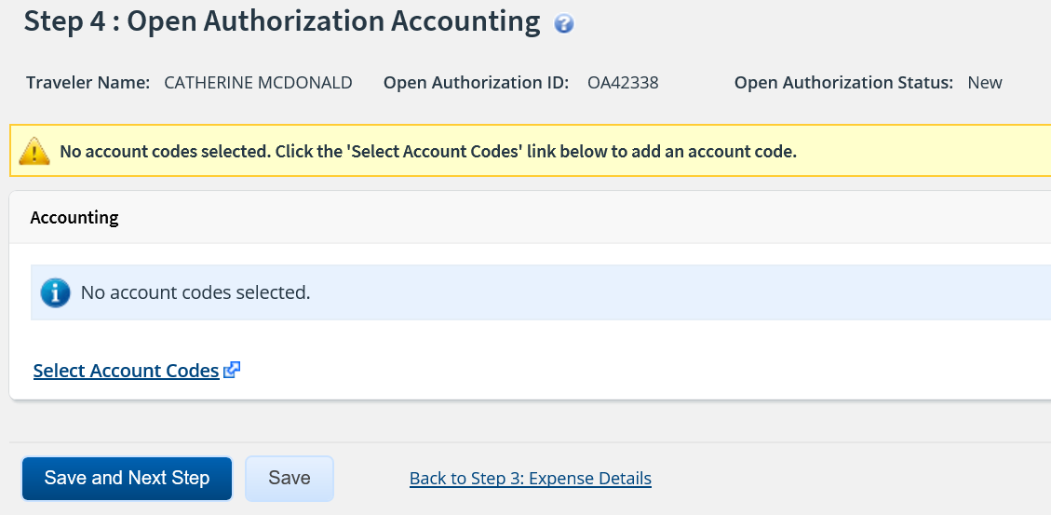
Creating an Open Authorization
Step 4: Accounting
Notes:
Your trips POET line or lines will be added by the Funds Manager Approver. You can click Save and Next Step to move to the Summary.

Slide 39
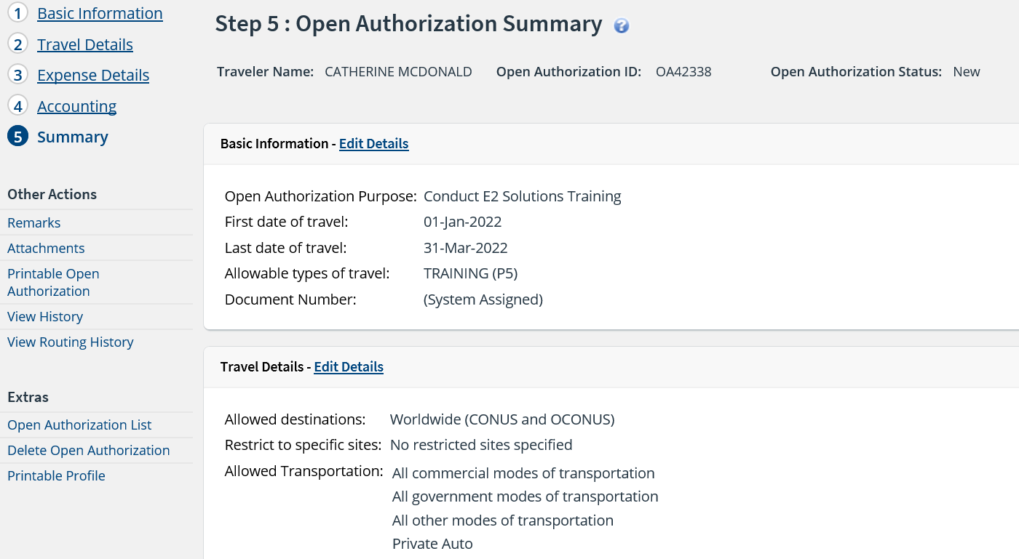
Creating an Open Authorization
Step 5: Summary
Notes:
The Summary step provides an opportunity for you to review the open authorization and make sure it is correct before you submit it for approval.

Slide 40
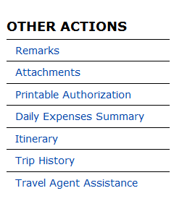
Creating an Open Authorization
Other Actions
Others Actions are links to functions that are not part of the Open Authorization workflow.
Located to the left in the navigation pane, the available actions vary depending where you are in the creation process.
Other Actions | Description
Remarks | Review or add remarks to the authorization
Attachments | View or add receipts or other documents to the OA.
Printable Open Authorization | View or print the OA.
View History | View history for the OA.
View Routing Path | View the open authorizations routing path. Available once the authorization is sent for approval
View Routing History | Displays an audit trail of routing events for the OA.
Notes:
The OTHER ACTIONS section of E2 contains links to commonly performed actions while creating open authorizations. Links vary depending on the status of the document and the step in the workflow that is currently displayed.

Slide 41
Creating an Open Authorization
Extras
Just below the Other Actions menu, the Extras section provides quick access to additional actions.
Common Extras links include leaving the workflow to view a document list or deleting the current document.
Extras | Description
Open Authorization List | Returns to open authorization list
Delete Open Authorization | Removes the open authorization
Printable Profile | Displays your profile and a printable version of your profile appears in a new browser window.
Notes:
The EXTRAS section of E2 contains links to other functionality available while creating authorizations. Links vary depending on the status of the document, and the step in the workflow that is currently displayed.

Slide 42
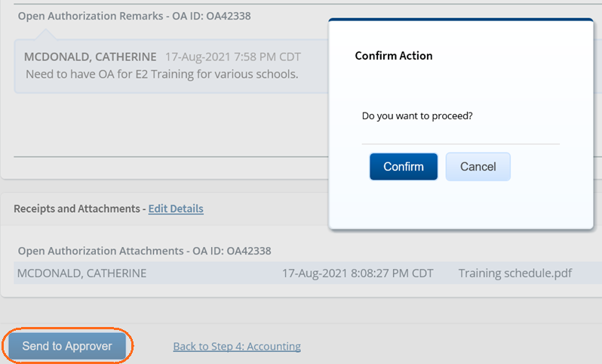
Creating an Open Authorization
Send to Approver
Notes:
Once the OA is complete, scroll to the bottom of the Summary page.
Click Send to Approver to submit the authorization.
Validation checks are performed and any exceptions will be listed in the Confirm Action modal.

Slide 43
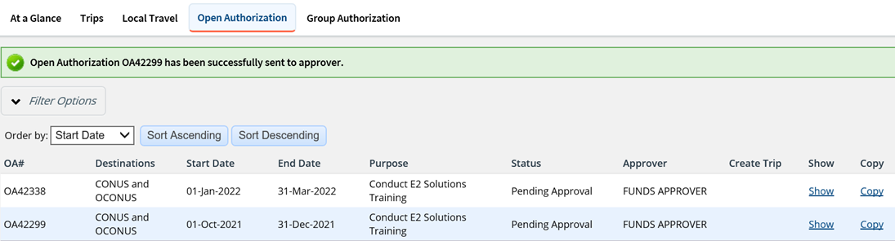
Creating an Open Authorization
Viewing OA List
Notes:
Once the OA is submitted for approval, it displays on your Open Authorization tab with a status of Pending Approval.
To view the open authorization, click Show.
If you need to change an open authorization after you submit it for approval but before it completes the approval process, you can recall the document.

Slide 44
Amending Open Authorizations

Slide 45
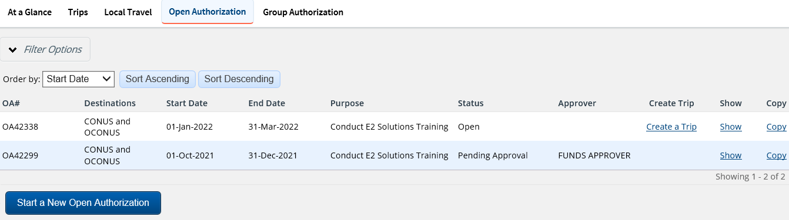
Amending Open Authorizations
An OA can be amended once it is approved and in a status of Open. Limited changes are permitted to an OA amendment once trips have been created under the OA.
Notes:
You can amend an open authorization created manually at any time when it has a status of Open.
If no trips have been created under the OA, you can change all information on all pages (i.e., Basic Information, Travel Details, Expense Details, Accounting, and Summary).
Options that you are allowed to change will be enabled as you proceed through the OA amendment workflow.
Locate the open authorization you want to amend on the My E2 Open Authorization tab.
Click the Show link. This displays the Open Authorization Dashboard page for that OA.
Note: You cannot amend an OA in E2 if it was started/sourced by the automated process from DA.

Slide 46
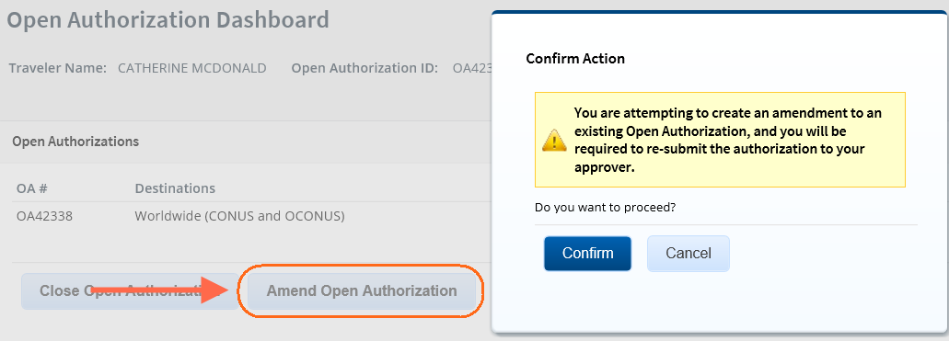
Open Authorization Dashboard
Notes:
Click Amend Open Authorization. A Confirm Action window displays to alert you that you are attempting to create an amendment to an existing open authorization, and that you will be required to resubmit the OA to your approver.
Click Confirm. This displays the Open Authorization Basic Information page.

Slide 47

Amending an Open Authorization
Step 1: Basic Info
Notes:
Once the Open Authorization process starts, the Open Authorization ID is updated with a ‘-1’ to indicate it has been amended.
Review and make changes to the Basic Information.
Click Save and Next Step.

Slide 48
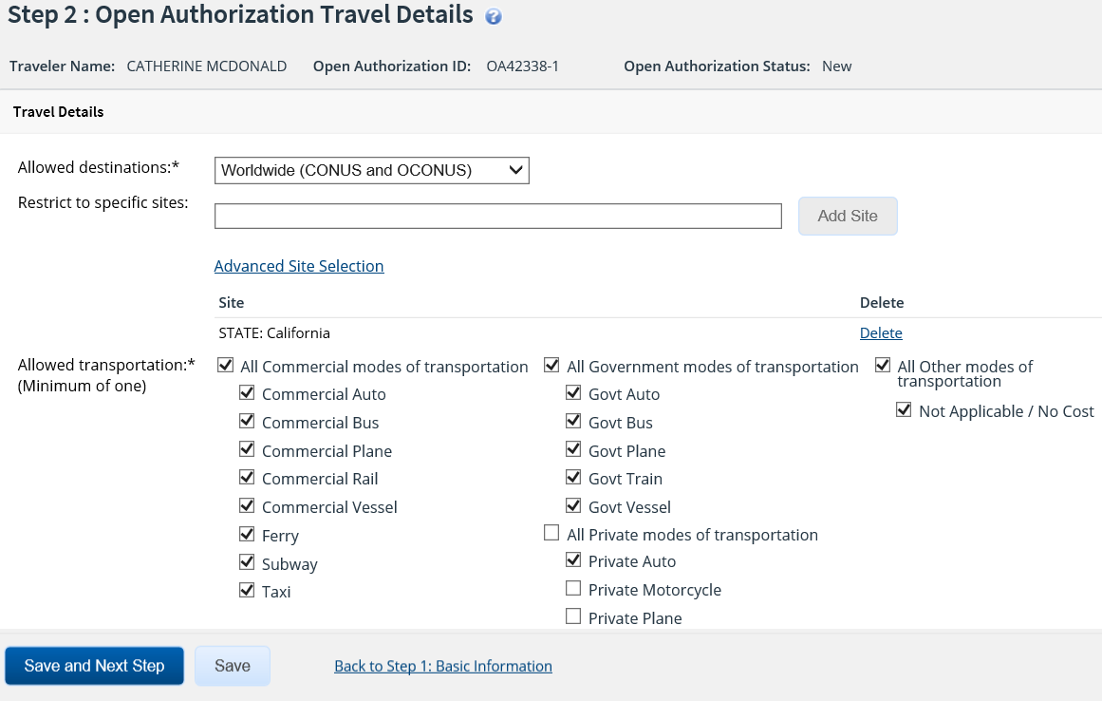
Amending an Open Authorization
Step 2: Travel Details
Notes:
Review and make changes to the Travel Details.
Click Save and Next Step.

Slide 49
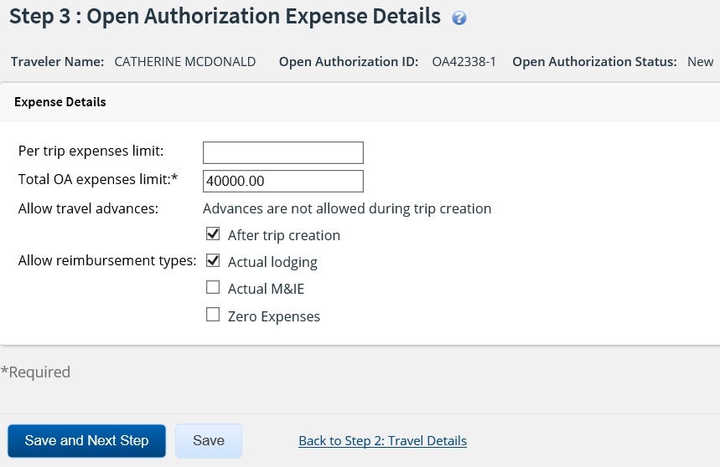
Amending an Open Authorization
Step 3: Expense Details
Notes:
Review and make changes to the Expense Details.
Click Save and Next Step.

Slide 50
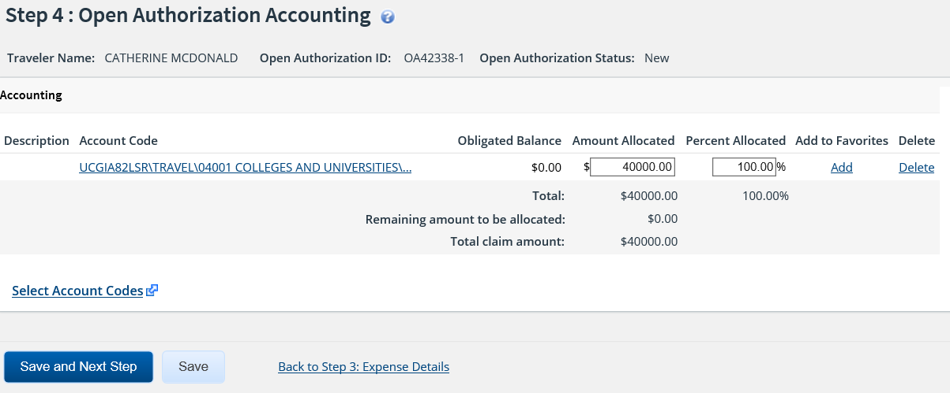
Amending an Open Authorization
Step 4: Accounting
Notes:
The account codes (POET) used on the original authorization carry over to the amended authorization.
Your funds approver will adjust the account codes if necessary.
Click Save and Next Step.

Slide 51
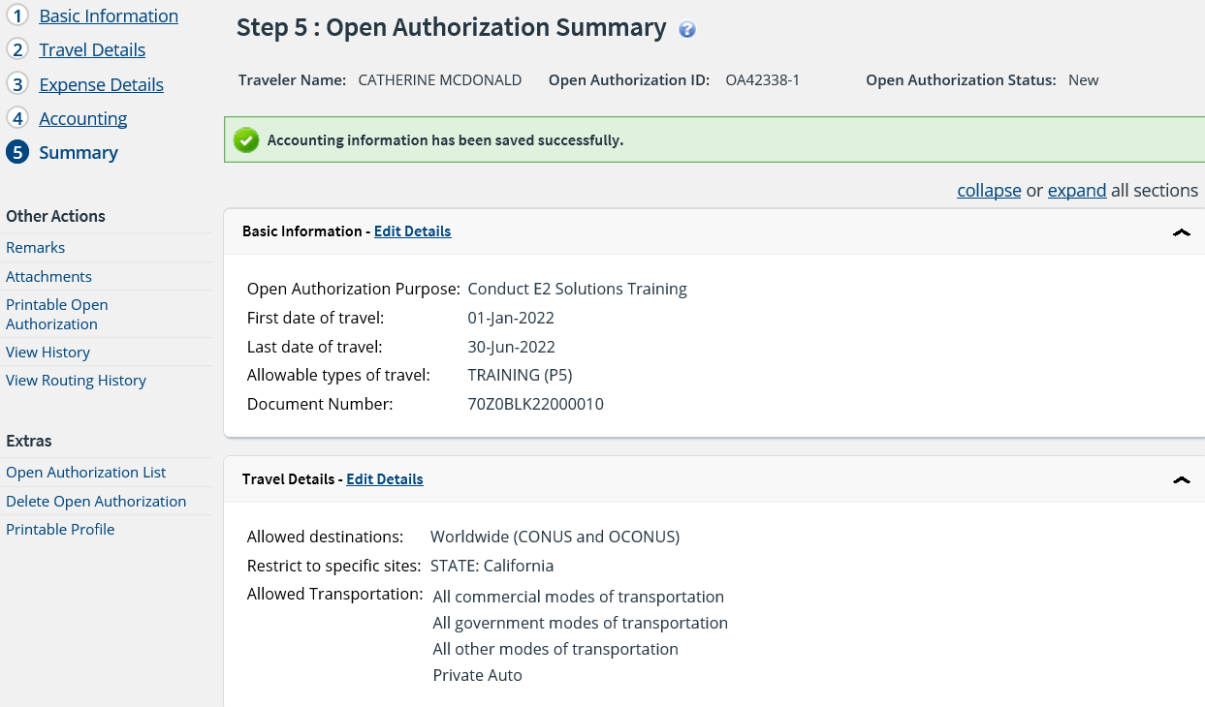
Amending an Open Authorization
Step 5: Summary
Notes:
The Summary step provides an opportunity for you to review the open authorization and make sure it is correct before you submit it for approval.

Slide 52
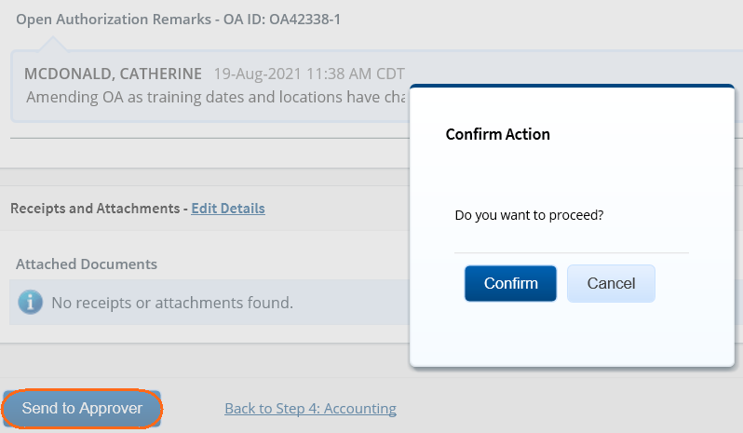
Amending an Open Authorization
Send to Approver and Confirm
Notes:
Once the OA is complete, scroll to the bottom of the Summary page.
Click Send to Approver to submit the authorization.
Validation checks are performed and any exceptions will be listed in the Confirm Action modal.

Slide 53
Creating Trips from
Approved OA

Slide 54
Scenario 3
Create a Trip from Approved Open Authorization
The traveler’s open authorization has been approved and needs to create a trip using the approved OA. The traveler is going round trip from Washington, DC (IAD) to Los Angeles, CA (LAX).
Review options to start the trip under an OA. Select start the authorization from the Trips tab.
Use the information below to create and complete the authorization.
Basic Information:
Type of Travel: Site Visit
Purpose: Conduct Site Inspections
Reservation:
Book round trip flights and a hotel in Los Angeles, CA.
Expenses:
Airfare: Amount from reservation booked automatically populates
Checked Bag Fee: Estimate $50 round trip
Lodging: Use reimbursement type Per Diem and amount from reservation
Estimated Lodging Tax: Estimate $20/per night
M&IE: Automatically populates Per Diem based on location from Site Details
TMC Fee: Online Booking $9.35 (will automatically populate)
Transportation Network Company Uber/Lyft: $200
* Instructor may adjust travel details as needed

Slide 55
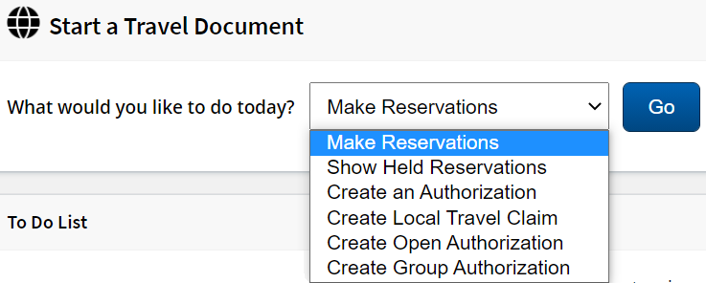
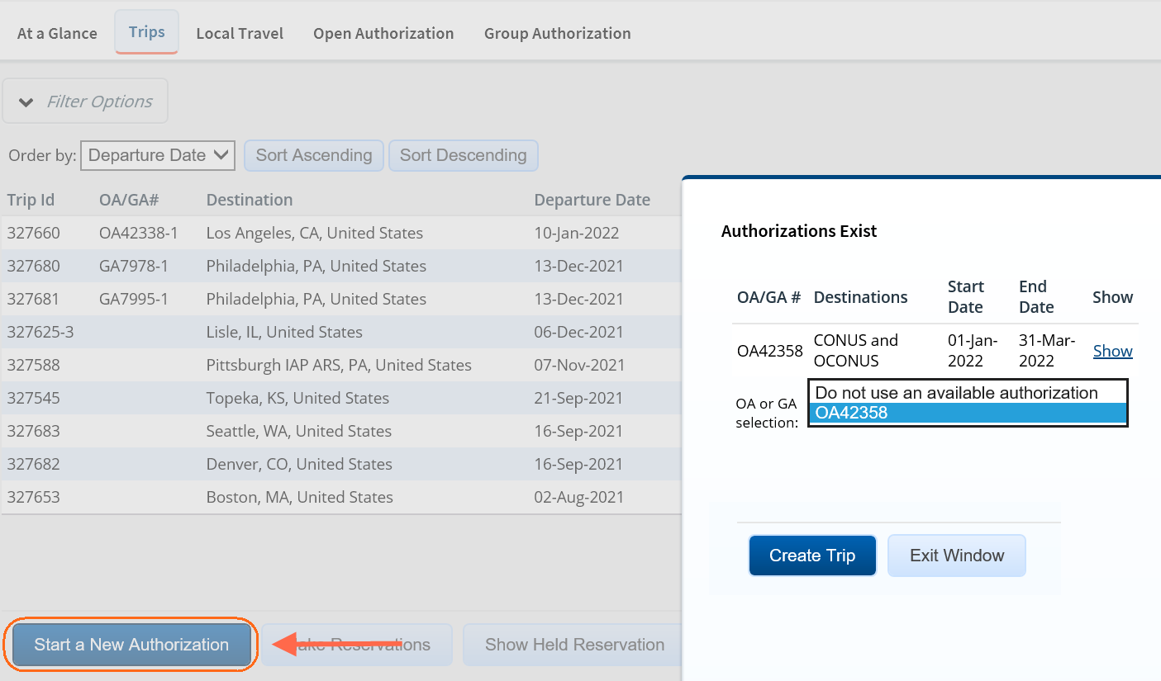
Creating a Trip from an OA
Start from My E2 Start a Travel Document
Notes:
After your open authorization is approved, you can make requests to travel under that OA.
A travel authorization created under an OA is very similar to a simple request to travel with a one-time itinerary.
If an authorization created under an OA conforms to the OA limitations, that authorization does not require additional approvals.
Trips can be created from the Start a Travel Document list on the At a Glance page or from the Trips tab.
If approved OAs exist, you are prompted to select which OA you would like to create the trip under.

Slide 56
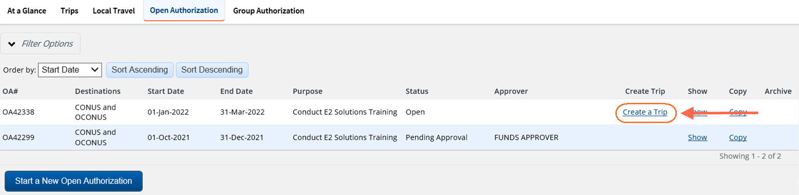
Creating a Trip from an OA
Start from Open Authorization Tab
Notes:
Trips can also be created from the Open Authorizations tab by clicking the Create a Trip link for the OA which it is to be created under.

Slide 57
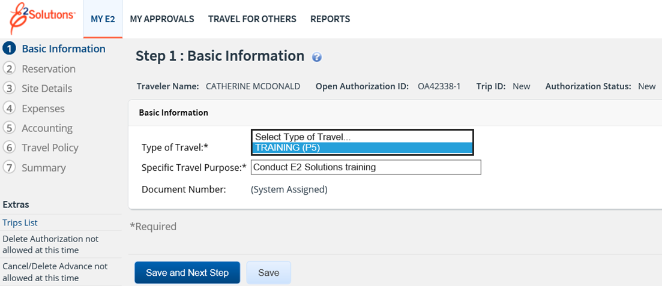
Creating a Trip from an OA
Step 1: Basic Information
Notes:
Select the type of trip you are creating from the Type of Travel drop-down list. The list is restricted to the types of travel allowed by the OA.
Enter the purpose of your trip in the Specific Travel Purpose field. This entry is for the trip only and may differ from the open authorization's purpose.
Click Save and Next Step.

Slide 58
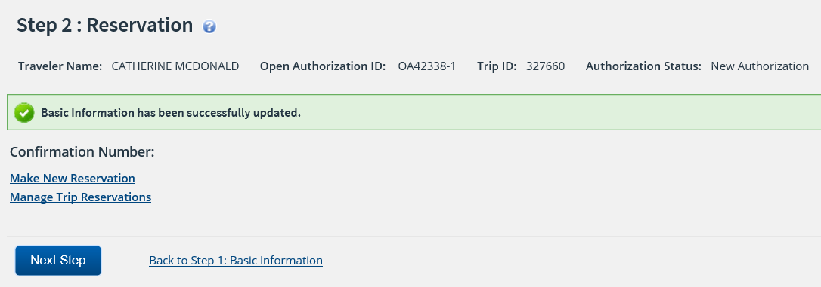
Creating a Trip from an OA
Step 2: Reservation
Notes:
Making a reservation for a trip from an open authorization is no different than making a reservation or managing trip reservations for a TDY trip.
Once you have made your reservation or associated a previously booked reservation to your trip from the open authorization, click Next Step to continue.

Slide 59
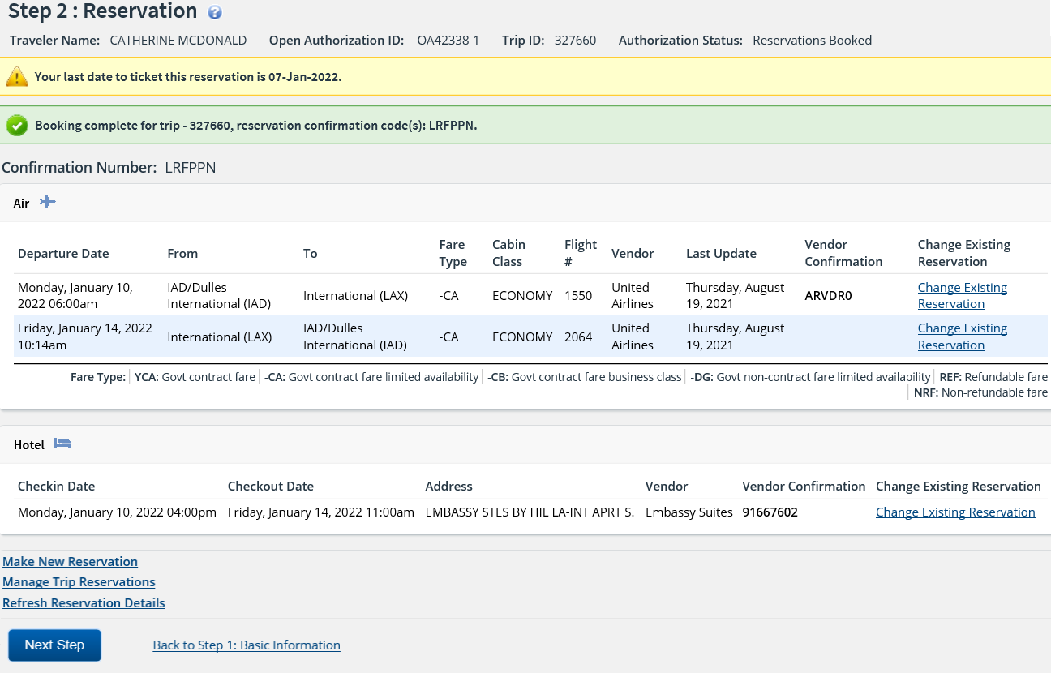
Creating a Trip from an OA
Step 2: Reservation

Slide 60
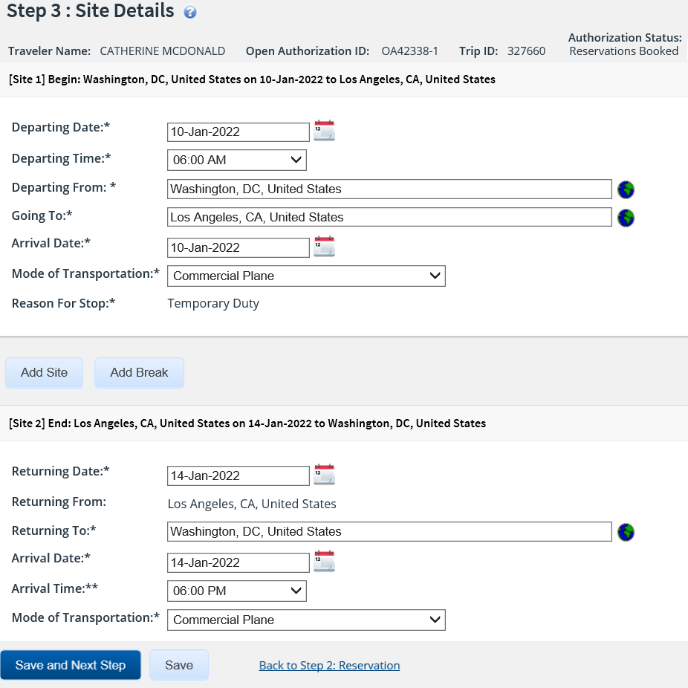
Creating a Trip from an OA
Step 3: Site Details
Notes:
Complete the Site Details step, and then click Save and Next Step to continue.
If the authorization has associated reservations, the information on this page comes from reservation details. You should review this information and verify that the per diem locations are correct.
The dates, sites, and modes of transportation you can select are restricted to those values allowed by the OA. If you enter a value that is not allowed by the OA, an error message displays

Slide 61
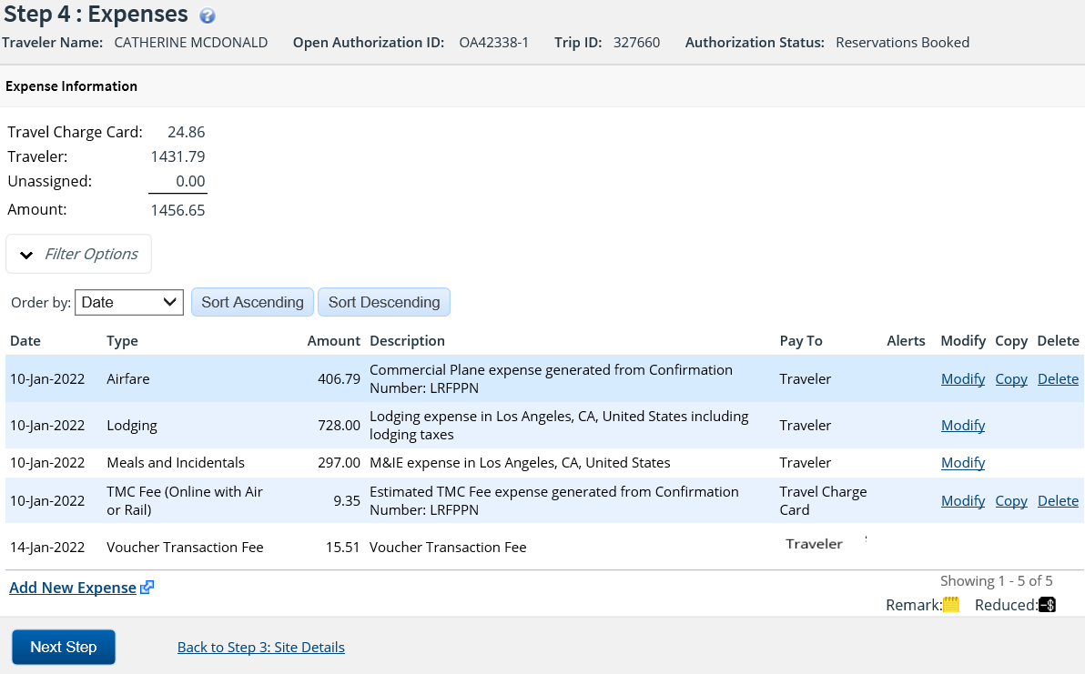
Creating a Trip from an OA
Step 4: Completing Expenses
Notes:
Complete the authorization's Expenses step, and then click Next Step to continue.
Allowable reimbursement types are controlled by the OA allowable reimbursement types.

Slide 62
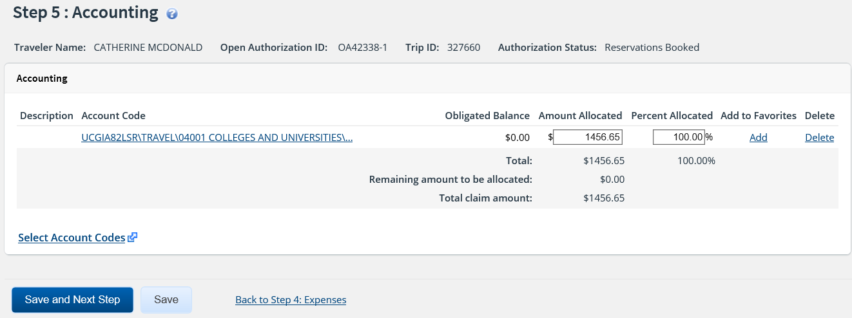
Creating a Trip from an OA
Step 5: Accounting
Notes:
Your trip’s POET line or lines will be added by the Funds Manager Approver. You can click Save and Next Step to move to Step 6: Travel Policy.

Slide 63
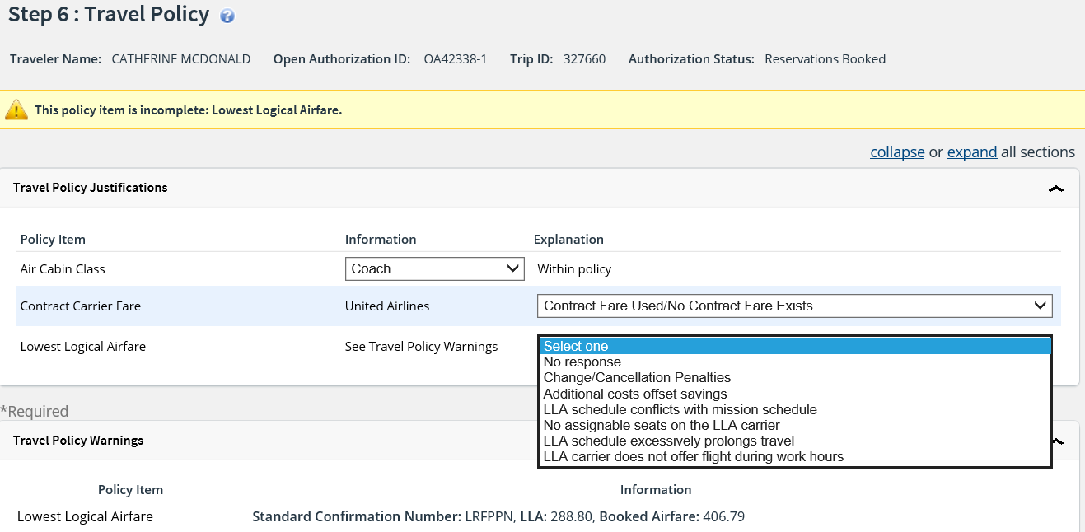
Creating a Trip from an OA
Step 6: Travel Policy
Notes:
Review and complete the travel policy step.

Slide 64

Creating a Trip from an OA
Step 6: Travel Policy
Notes:
Click Save and Next Step to move to the trip’s summary.

Slide 65

Creating a Trip from an OA
Step 7: Summary
Notes:
The Summary step allows you to review the authorization and make sure it is correct before you submit it for approval.
Use Edit Details within a section header to return to that step in the workflow process to make changes.
Be sure to save changes and work your way back to the summary.

Slide 66

Creating a Trip from an OA
Complete and Confirm
Notes:
Click Complete Trip Authorization found at the bottom of the summary page.
If your trip has errors, warning and error messages display at the top of the page. Fix your errors, return to the Summary page, and then click Complete Trip Authorization again.
If your trip has no errors, a Confirm Action window displays.
Click Confirm.

Slide 67

Authorization Approved
Notes:
After clicking Complete Trip Authorization, you are returned to the Trips list.
The status of the trip is now approved.
If a reservation is associated to the trip, the approval information from the OA is updated in the reservation

Slide 68
Closing Open Authorizations

Slide 69

Closing Open Authorizations
When you no longer need to create new trips under the OA, the traveler or arranger can close the OA.
Trips already created under the OA can be completed, but you cannot create any new trips under the OA.

Slide 70

Closing Open Authorizations
Confirm
Notes:
An Open Authorization can be closed from the OA Dashboard.
Click Close Open Authorization.
Click Confirm.

Slide 71

Closing Open Authorizations
Dashboard
Notes:
Once the open authorization is closed, no other trips can be created under the open authorization.

Slide 72
Review
Open Authorizations
What is the maximum time frame an open authorization can cover?
An open authorization can cover 1 year.
No, trips under an OA cannot be created until the OA is approved.
Can a traveler creating trips under an open authorization before it is approved?
When creating a trip under an approved OA, can dates not included in the OA be entered on the Site Details page?
No, you will receive an error if you enter dates that are outside of the approved OA.
Once an Open Authorization is closed, can you complete a voucher for a trip you took last month under that OA?
Yes, you can complete a voucher for a trip already created. You cannot create a new trip once the OA has been closed.

Slide 73

Break Time
Let’s take a break!
WebEx Training:
Please stay logged in to the WebEx and the audio.
We will see you shortly!

Slide 74
Creating Group Authorizations

Slide 75
Group Authorizations
A group authorization is a way to pre-plan travel for a group and receive approval before the individual travelers make specific travel plans.
Group authorizations are “parent” documents; travelers or arrangers create individual reservations and travel authorizations under the group authorization once it is approved.
A group authorization must include at least two travelers. You are limited to select travelers within the same Minor Customer.
The person creating the group authorization is the owner of the GA. As the owner of the group authorization, you may also be a traveler on the group authorization, though this is not a requirement.
The GA owner is the only user that can amend or cancel a GA.
Notes:
If an Arranger accesses Travel for Others to create the GA on another user’s behalf, that user for whom the arranger is creating becomes the owner of the GA. The arranger should create the GA as their own document if the arranger wants to be the owner of the GA.

Slide 76


Creating Group Authorizations
Notes:
Similar to the previous documents discussed, Group Authorizations can be created from Start a Travel Document list on the My E2 At a Glance page or from the Group Authorization tab by clicking Start a New Group Authorization.

Slide 77
Scenario 4
Create Group Authorization:
Several travelers in the Washington, DC office will be attending a travel conference together. A group authorization will be created to accommodate this request.
Basic Information
Type of Travel: Conference Attendance
Specific Travel Purpose: Travel Conference
Site Details
Destinations: Philadelphia, PA
Mode of Transportation: Private Auto
(Most travelers will be driving from the DC area. Travelers can select a different mode of transportation when creating trip if needed.)
Travelers:
Several travelers within the same workgroup will be selected.
Expense Details:
Estimated Expenses per Traveler: $2000
Reimbursement Types: Zero Expenses (Actual Lodging or M&IE will not be permitted for these trips)
* Instructor may adjust travel details as needed

Slide 78

Creating a Group Authorization
Step 1: Basic Information
Notes:
Basic Information for a group authorization includes:
Type of travel
Travel purpose
Document number
When you complete and save the basic information page E2 creates the GA document and assigns it a GA Id and document number.

Slide 79

Creating a Group Authorization
Step 2: Site Details
Notes:
The Site Details page for a group authorization is very similar to the Site Details page for an authorization.
Use this page to provide travel details for the group. These details become the limitations for group authorizations travelers.
Authorizations created under the group authorization much conform to the specifications to automatically inherit the approval status of the group authorization. If they do not, the authorization will route for individual approval.

Slide 80

Creating a Group Authorization
Step 3: Travelers
Notes:
This step allows you to select the travelers that will be part of the group. When the group authorization is approved, each traveler will be notified via email and may see to To Do list item to create a travel authorization for the GA.
A group authorization much include at least two travelers. As owner of the group authorization, you may also be a traveler within the group.
You can authorize one or more Travelers to book a rental car for the trip. Only travelers who are authorized to book a rental car can add a rental car reservation to their authorization for the GA without requiring the authorization to be routed for approval.
Travelers who are not authorized to book a rental car are not prevented for making rental car reservation, but this action will cause the authorization created from the GA to be routed for approval.

Slide 81

Creating a Group Authorization
Step 4: Expense Details
Notes:
The Expense step requires you to provide an estimate of expenses per traveler. Any trips created from the GA that exceeds the estimated expenses threshold will be routed for approval.
You can also select additional reimbursement types that will be available to the travelers for the trips created from the GA. The per diem, reduced and conference reimbursement types are always available.

Slide 82

Creating a Group Authorization
Step 5: Accounting
Notes:
Your trip’s POET line or lines will be added by the Funds Manager Approver. You can click Save and Next Step to move to the Summary.

Slide 83

Creating a Group Authorization
Step 6: Summary
Notes:
The Summary step provides an opportunity for you to review the group authorization and make sure it is correct before you submit for approval.

Slide 84
Creating a Group Authorization
Other Actions
Others Actions are links to functions that are not part of the basic authorization workflow.
Located to the left in the navigation pane, the available actions vary depending where you are in the authorization creation process.
Other Actions | Description
Remarks | Review or add remarks to the authorization
Attachments | View or add receipts or other documents to the GA.
Printable Group Authorization | View or print the GA.
View History | View history for the GA.
View Routing Path | View the group authorizations routing path. Available once the authorization is sent for approval
View Routing History | Displays an audit trail of routing events for the GA.
Notes:
The OTHER ACTIONS section of E2 contains links to commonly performed actions while creating group authorizations. Links vary depending on the status of the document and the step in the workflow that is currently displayed.

Slide 85
Creating a Group Authorization
Extras
Just below the Other Actions menu, the Extras section provides quick access to additional actions.
Common Extras links include leaving the workflow to view a document list or deleting the current document.
Extras | Description
Group Authorization List | Returns to open authorization list
Delete Group Authorization | Removes the open authorization
Printable Profile | Displays your profile and a printable version of your profile appears in a new browser window.
Notes:
The EXTRAS section of E2 contains links to other functionality available while creating group authorizations. Links vary depending on the status of the document, and the step in the workflow that is currently displayed.

Slide 86

Creating a Group Authorization
Send to Approver
Notes:
Once the GA is complete, scroll to the bottom of the Summary page.
Click Send to Approver to submit the authorization.
Validation checks are performed and any exceptions will be listed in the Confirm Action modal.

Slide 87
Amending Group Authorizations

Slide 88

Amending a Group Authorization
After the group authorization is approved, the owner of the group authorization can amend the group authorization.
Notes:
You can make changes to a group authorization by amending the approved GA. You can change the following information:
Travel dates
Travelers
NOTE: You can add or remove travelers. You cannot, however, remove a traveler from the GA if they have created an authorization under the GA, and that authorization has been approved.
Estimated expenses per traveler
Reimbursement types
To begin the amendment, locate the group authorization you want to amend on the My E2 Group Authorization tab.
Click Show.

Slide 89

Amending a Group Authorization
Dashboard
The Group Authorization Dashboard shows the Travelers for this GA and allows you to take additional actions.
Notes:
The Group Authorization Dashboard page for that GA is displayed.
Click Amend Group Authorization.

Slide 90

Amending a Group Authorization
Confirm
Notes:
A Confirm Action window displays to alert you that you are attempting to create an amendment
to an existing group authorization, and that you will be required to resubmit the GA to your approver.
Click Confirm.

Slide 91

Amending a Group Authorization
Step 1: Basic Information
Notes:
This Group Authorization Basic Information page is displayed.
You cannot change any of the basic information.
Click Next Step.

Slide 92

Amending a Group Authorization
Step 2: Basic Information
Notes:
Adjust the dates on the Site Details step, and then click Save and Next Step to continue.
You cannot adjust the TDY destination or mode of transportation.

Slide 93

Amending a Group Authorization
Step 3: Travelers
Notes:
On the Travelers step, remove any travelers who will not be traveling under the GA.
Use the Select Travelers link to add additional travelers.
Click Save and Next Step.

Slide 94

Amending a Group Authorization
Step 4: Expense Details
Notes:
Enter an updated Estimated Expenses per Traveler if needed.
Adjust allowable reimbursement types.
Click Save and Next Step.

Slide 95

Amending a Group Authorization
Step 5: GA Accounting
Notes:
The account codes (POET) used on the original authorization carry over to the amended authorization.
Your funds approver will adjust the account codes if necessary.
Click Save and Next Step.

Slide 96

Amending a Group Authorization
Step 6: Summary
Notes:
The Summary step provides an opportunity for you to review the group authorization and make sure it is correct before you submit it for approval.

Slide 97

Amending a Group Authorization
Send to Approver and Confirm
Notes:
Once the GA is complete, scroll to the bottom of the Summary page.
Click Send to Approver to submit the authorization.
Validation checks are performed and any exceptions will be listed in the Confirm Action modal.

Slide 98
Creating Trip from Group Authorization

Slide 99
Scenario 5
Create Trip from Approved Group Authorization
The group authorization has been approved for the upcoming travel conference The traveler is driving their POV from Washington, DC to the conference in Philadelphia, PA.
Review options to start the trip under a GA and select to begin the trip from the To Do List.
Basic Information:
Type of Travel: Conference Attendance
Purpose: Attend Travel Policy Conference
Reservations: Not needed for this trip. Hotel reservations have been booked by the conference organizer.
Expenses:
Lodging: Hotel has been booked at the per diem rate
Estimated Lodging Tax: Estimate $20/per night
M&IE: Automatically populates per diem based on location from Site Details
Privately Owned Vehicle: From: 2703 Martin Luther King Jr Ave SE, Washington, DC To: Hyatt Hotel Philadelphia, PA
Privately Owned Vehicle: From: Hyatt Hotel Philadelphia PA To: 2703 Martin Luther King Jr Ave SE
Tolls $20
* Instructor may adjust travel sites as needed

Slide 100

Creating a Trip from an GA
Start from My E2 Start a Travel Document
Notes:
After your group authorization is approved, the trips for the included travelers can be created.
A travel authorization created under the GA is very similar to a simple request to travel with a one-time itinerary.
The authorization created under an GA is restricted to the GA limitations.
Trips can be created from the Start a Travel Document list on the At a Glance page or from the Trips tab.
If an approved GAs exist, you are prompted to select which GA you would like to create the trip under.

Slide 101

Creating a Trip from a GA
Step 1: Basic Information
Notes:
Verify the Basic Information. The Type of Travel and Purpose is populated from the approved group authorization.
Click Save and Next Step.

Slide 102

Creating a Trip from a GA
Step 2: Reservations
Notes:
Making a reservation for a trip from a group authorization is no different than making a reservation or managing trip reservations for a TDY trip.
Once you have made your reservation or associated a previously booked reservation to your trip from the group authorization, click Next Step to continue.

Slide 103

Creating a Trip from a GA
Step 3: Site Details
Notes:
Complete the Site Details step, and then click Save and Next Step to continue.
If the authorization has associated reservations, the information on this page comes from reservation details. You should review this information and verify that the per diem locations are correct.
The dates, sites, and modes of transportation are populated based on the limitations of the GA. If you enter a value that is not permitted, an error message displays

Slide 104

Creating a Trip from a GA
Step 4: Expenses
Notes:
Complete the authorization's Expenses step, and then click Next Step to continue.
Allowable reimbursement types are controlled by the GA allowable reimbursement types.

Slide 105

Creating a Trip from a GA
Step 5: Accounting
Notes:
Your trip’s POET line or lines will be added by the Funds Manager Approver. You can click Save and Next Step to move to Step 6: Travel Policy.

Slide 106

Creating a Trip from a GA
Step 6: Travel Policy
Notes:
Review the travel policy step and enter any explanations not populated.
Click Save and Next Step to move to the Summary.

Slide 107

Creating a Trip from a GA
Step 7: Summary
Notes:
The Summary step allows you to review the authorization and make sure it is correct before you submit it for approval.
Use Edit Details within a section header to return to that step in the workflow process to make changes.
Be sure to save changes and work your way back to the summary.

Slide 108

Creating a Trip from a GA
Complete and Confirm
Notes:
After all steps have been completed, scroll down to the bottom of the summary.
Click Complete Trip Authorization.
Click Confirm.
The trip will automatically inherit the approval status of the group authorization, and does not require additional approval steps.
Once the trip is complete, the voucher process for a trip under a GA is the same as a basic trip-by- trip authorization.

Slide 109
Canceling Group Authorizations

Slide 110

Canceling a Group Authorization
After the group authorization is approved, the owner of the GA can cancel the group authorization.
Notes:
Access the Group Authorization Dashboard.
Click Cancel Group Authorization.
Click Confirm.

Slide 111
Review
Group Authorizations
A GA must have at least 2 travelers.
What is the minimum number of travelers needed for a group authorization?
Can you create one group authorization for travelers that are in different workgroups (Minor Customers) ?
No, all travelers on a GA must be in the same minor customer.
Once a group authorization is approved, travelers can begin creating their trip from the At a Glance or Trips page. True or False ?
True
If the traveler creates a trip that exceeds the
per trip expense amount entered on the GA, what happens when the traveler clicks Complete Authorization?
The authorization will route for approval.

Slide 112
Creating
Supplemental Vouchers

Slide 113

Supplemental Vouchers
A supplemental voucher is created, after the final voucher is complete, to cover travel expenses that were not included on other vouchers.
Notes:
Access the Trips list and click Show for the trip you need to create a supplemental voucher for.

Slide 114
Scenario - 6
Create Supplemental Voucher
The traveler has returned from a recent trip. A final voucher has been approved and the traveler has been reimbursed.
The traveler realized they forgot to include several expenses and would like to submit those for reimbursement.
Create a supplemental voucher, enter the expenses below and submit it for approval.
Expenses:
Taxi $16 hotel to office
Taxi $22.50 office to hotel
TNC Lyft or Uber $19 hotel to airport

Slide 115

Creating a Supplemental Voucher
Notes:
From the Trip Dashboard, click Create Voucher to create a supplemental voucher.

Slide 116

Creating a Supplemental Voucher
Step 1: Basic Information
Notes:
The Basic Information page does not allow changes to the voucher cut-off date.
Review the information and click Save and Next Step.

Slide 117

Creating a Supplemental Voucher
Step 2: Expenses
Notes:
All lodging, meals, and incidental expenses are ineligible to be claimed on a supplemental voucher.
Click Add New Expense to add a new expense.
Click Add Credit Card Expenses to view transactions made on your GTCC and add them to your voucher.

Slide 118

Creating a Supplemental Voucher
Step 3: Accounting
Notes:
The account codes used on the authorization carry over to the voucher.
If multiple POET lines were used to fund the trip, allocations may need to be adjusted.
Click Save and Next Step.

Slide 119

Creating a Supplemental Voucher
Step 4: Summary
Notes:
The Summary step allows you to review the voucher and make sure it is correct before you submit it for approval.
Use Edit Details within a section header to return to that step in the workflow process to make changes.

Slide 120

Creating a Supplemental Voucher
Sending Voucher to Approver
Notes:
Scroll down to the bottom of the summary and click Send to Approver to submit the voucher.
Read the acceptance policy. When you submit the voucher, this acceptance is logged and becomes part of the trip history.
Click Confirm.
To return to the summary, click Cancel.

Slide 121
Resources
For more information on creating amendments, open authorizations, group authorizations and vouchers in E2 Solutions, access Online Help to view Computer Based Tutorials, User Guides and Quick Reference Cards:
QRC 23: Changing Reservations
UG 26, CBT 26, QRC 26: Amending Authorizations
UG 40, CBT 40, QRC 40: Creating Vouchers
UG 60, CBT 60, QRC 60: Creating Open Authorizations
UG 80, CBT 80, QRC 80: Creating Group Authorizations

Slide 122
Questions ?

